Slide 1
Enhancing Urban Cities Air Quality Prediction Using Deep Learning Techniques
Victoria Kovuru
URK20CS1074
GUIDE:
Dr. D. Narmadha

Slide 2
Agenda
PROBLEM STATEMENT
Introduction
OBJECTIVE
LITERATURE SURVEY
PROPOSED ARCHITECTURE
IMPLEMENTATION
RESULTS

Slide 3
Problem STATEMENT
In the face of escalating industrial modulation and its adverse effects on air quality, the urgent need arises for precise and efficient air quality prediction models. Addressing the dynamic and multifaceted nature of air quality, this study aims to develop advanced prediction frameworks, employing Bi LSTM algorithms to achieve superior performance compared to conventional LSTM models.

Slide 4
Introduction
Air quality is a critical component of our environment, influencing human health, overall well-being, and ecosystem integrity. Amidst urbanization, industrialization, and increased vehicular emissions, concerns about air pollution have intensified.
Various pollutants such as particulate matter (PM), nitrogen dioxide (NO2), sulfur dioxide (SO2), carbon monoxide (CO), volatile organic compounds (VOCs), and ground-level ozone (O3) compromise air quality.
Prolonged exposure to these pollutants poses serious health risks, leading to respiratory and cardiovascular issues and even premature mortality. Additionally, air pollution has detrimental effects on vegetation, wildlife, and ecosystems. Delhi, India's capital, renowned for its rich heritage, and vibrant streets, has also faced global attention due to severe and persistent air quality issues, particularly concerning fine particulate matter (PM2.5), impacting public health significantly.

Slide 5
OBJECTIVE OF THE PROJECT
Develop an advanced air quality prediction model for locations in India, integrating industrial emissions, meteorological variables, geographical features, emission sources, and chemical reactions, Using Deep learning techniques and determining the best working model.

Slide 6
LITERATURE SURVEY

Slide 7
( [1] DeepAir ). LSTM and BiLSTM models are performed in short-term traffic data-driven models. It was proposed to predict parameters such as travel time, speed, volume, and density. The model includes ARIMA to help with traffic problems
Deep learning techniques have been extensively employed in air quality prediction due to air quality data’s ability to expose complicated temporal and geographic patterns. A range of hybrid architectures and LSTM have been utilized for air quality prediction. Air quality prediction with deep learning is attainable via Deep Air.
Researchers have used LSTM and BiLSTM architectures in Deep Air to model the temporal dependencies in air quality data. This approach has been applied to various cities for short and long terms for air quality prediction.

Slide 8
Certainly, floods are among the most common and devastating natural disasters, and they represent a significant danger to our communities.
Having practical and efficient methods for predicting floods is incredibly important because it allows us to respond quickly to prevent and mitigate the disaster’s impact.
This, in turn, helps save lives, protect property, and maintain the overall stability of our society. To address these various analysis methods are used such as signal processing

Slide 9
Research on estimating uncertainty in air quality predictions using LSTM and BiLSTM models has also progressed. Uncertainty quantification is crucial for decision-making and risk assessment.
hourly PM2.5 concentration forecast on a spatiotemporal causal convolutional network. The use of multimodal LSTM models that incorporate data from multiple sources, such as meteorological data, traffic data, and satellite imagery, in addition to air quality data.
Based on the wide range of performance of neural networks produces patterns that were a better stand for predicting the FOREX Rate within a 60-minute duration, the proposed approach determines the market’s EUR/USD exchange rate.

Slide 10
Timeseries prediction utilizing transductive LSTM: A weather forecasting application, Building an LSTM model from the dataset gathered at the weather underground website with real measurements determining the best model by performance metrics MSE, MAE with the developed parameters of LSTM as tanh and sigmoid. At the end an LSTM model for temperature prediction.
Multivariate classification, LSTM-FCN is used for classifying univariate time series. Applied to other variant classification problems. The proposed model converts univariate to multivariate variants. state-of-the-art algorithms are compared with the proposed model.

Slide 11
Bidirectional layer formation through matrices using lowercase and uppercase letters then Temporal Attention-Augmented Bilinear Layer is to predict sequence to sequence learning.
High-frequency trading forecasting is challenging in trading. A technique for automated inference could assist in speed and accuracy. The proposed model incorporates bilinear projection along with an attention mechanism.
Inability to get ideal settings using useful tools for MA. MA optimization was used on the historical dataset. MA bias detection was included for multiple MA procedures.
LSTM corresponds with both space and time, and it can manage severe artificial long lag challenges.

Slide 12
 |  | YEAR | PAPER | AUTHOR | METRICS | DATASET | LIMITATIONS
1 | Stock Price Prediction using Depthwise Pointwise CNN with Sequential LSTM | 2023 | Ashish Rajanand; Pradeep Singh | Depth-wise Separable CNN with Sequential LSTM (DWCNN-SLSTM) | MAPE - 0.47,0.50,0.48,0.477 | S&P 500, HSI, CSI300, and Nikkei 225 datasets. | ROBUST TO LAGE DATA
2 | Based on the Improved PSO-TPA-LSTM Model Chaotic Time Series Prediction | 2023 | Zijian Cai 1,Guolin Feng 1,2 andQiguang Wang 3,* | Particle Swarm Optimization,LSTM, The temporal pattern attention mechanism (TPA) | RMSE - 0.42, MAE - 0.35 , R2 - 0.4 | data generated from three different initial values of the Lorenz system | chaotic data complexity
3 | Application of Machine Learning in Process Control in Optical Fiber Manufacturing | 2023 | Othman, Mohamed | LSTM | ACCURACY | NA
4 | Comprehensive Hierarchical Classification of Transposable Elements based on Deep Learning | 2024 | Yang Qi, View ORCID ProfileYiqi Chen | Convolutional and Recurrent Neural Networks, Attention mechanisms, for efficient TE classification | ACCURACY,PRECISION,RECALL,F1,MCC | NA | Collecting data from various sectors
5 | VMD-AC-LSTM: An Accurate Prediction Method for Solar Irradiance | 2023 | Jianwei Wang, Ke Yan & Xiang Ma | Variational Modal Decomposition (VMD), Multi-head Self-Attention Mechanism, One-Dimensional Convolutional Neural Network (1D-CNN) and Bidirectional Long and Short-Term Memory Network (BiLSTM) | RMSE , R2, MAE | National Solar Radiation Database (NSRDB) | Historial data have been involved but not in present areas

Slide 13
6 | Qin, Q., Zhou, Z., Zhou, J., Huang, Z., Zeng, X. and Fan, B., 2024. Sentiment and attention of the Chinese public toward electric vehicles: A big data analytics approach. Engineering Applications of Artificial Intelligence, 127, p.107216. | 2024 | Qin, Q., Zhou, Z., Zhou | lstm rnn bilstm | Precision,Recall,F1-score | Sina Weibo
7 | Ren, H.W. and Abdullah, A.B., FORECATING NATURAL RUBBER PRICE IN MALAYISA BY USING BRANCHING BI-LSTM. | 2023 | Ren, H.W. and Abdullah, A.B., | LSTM,Bi-lstm | mse-4.7 | rubber production areas | no particular data details for the work
8 | Zhao, C., Hu, P., Liu, X., Lan, X. and Zhang, H., 2023. Stock market analysis using time series relational models for stock price prediction. Mathematics, 11(5), p.1130. | 2023 | Zhao, C., Hu, P., Liu, X., Lan, X. and Zhang, H | LSTM model,graph convolutional network | 4.9% and 6.6% | 1 January 2019 to 1 September 2020 | Although the TSRM model is a great improvement over the benchmark model in financial market analysis and forecasting, there are some limitations: (1)The large volume of data and variable market styles; the correlation can only be analyzed based on recent data. (2)This study did not incorporate external data, such as industry or concept data or macroeconomic indicators, to supplement the analysis. Incorporating such data may provide additional insights into the dynamics of the stock market.
9 | Zheng, W., Lu, S., Cai, Z., Wang, R., Wang, L. and Yin, L., 2023. PAL-BERT: An Improved Question Answering Model. Computer Modeling in Engineering & Sciences; Tech Science Press: Henderson, NV, USA. | 2023 | Zheng, W., Lu, S | TextCNN; BiLSTM | ACCURACY -81 | SQuAD1.1andSQuAD2.0
10 | Song, Y., Fan, C. and Mao, X., 2024. Optimization of epilepsy detection method based on dynamic EEG channel screening. Neural Networks, 172, p.106119. | 2024 | Song, Y., Fan, C. and Mao, | ICA algorithm , RCMDE algorithm, ResCon-LSTM neural network | ACCURACY -98 PRECISION RECALL | e CHB-MIT dataset

Slide 14
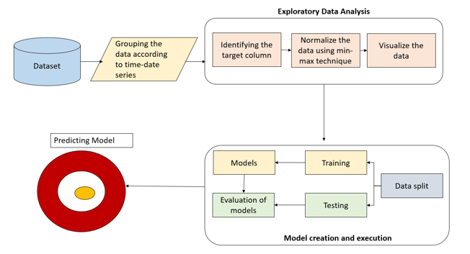
PROPOSED ARCHITECTURE

Slide 15
LAYERS OF PROPOSED MODEL
LSTM SINGLE HIDDEN LAYER
BiLSTM SINGLE HIDDEN LAYER
Represents the single hidden layer of the LSTM model it contains components such as sigma, and tan to perform mathematical calculations with the formulated equations.
As the BiLSTM model resembles the formation of multiple LSTM layers this is an illustration of these hidden layers over the developed BiLSTM model.

Slide 16
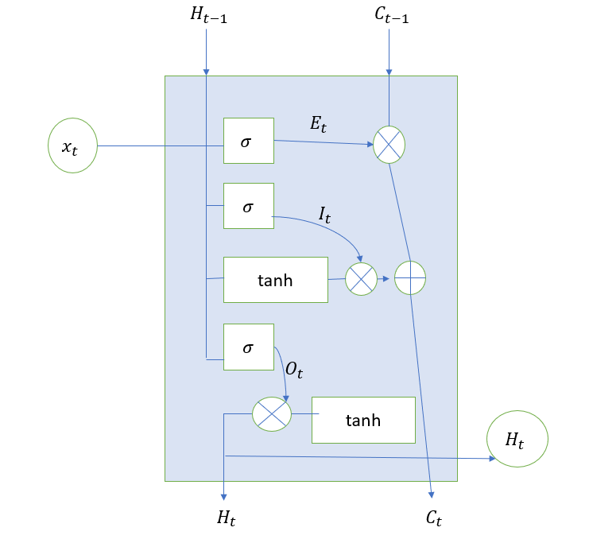
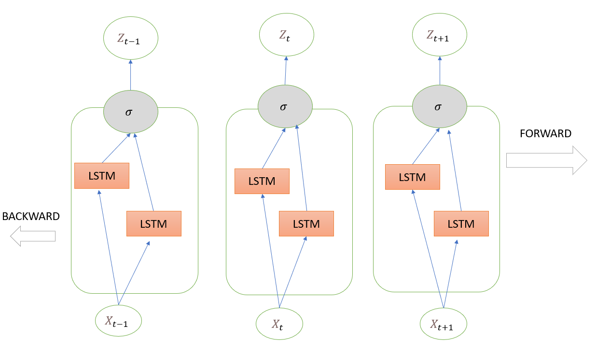
LSTM
BiLSTM

Slide 17
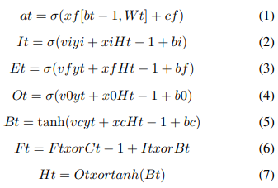
IMPLEMENTATION
Suppose yt and Ht-1 These hidden layers are measured using these equations, given the ordered input data and the output state at time t..
xi, xf, xo, and xc, which symbolize the recurrent xi, xf, xo, and xc, which symbolize the recurrent Weight matrices are assigned to four different gates: input, forgetting, output, and memory cell gates. They are represented by vi, vf, vo, and vc, respectively. These matrices are integral components within a neural network, playing pivotal roles in controlling information flow, retention, and processing at various stages of computation.
EQUATIONS

Slide 18
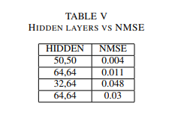
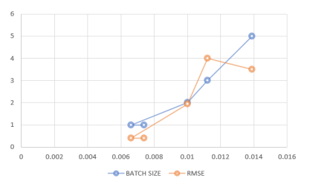
results
Gather the values of hidden layers along with the NMSE score that varies accordingly with hidden layers. This is one of the hyperparameters that allows the model to work much more accurately.

Slide 19
RESULT
MODEL | LAYERS |  | NMSE | RMSE
 | HIDDEN | NO.OF. LAYERS
LSTM | 50 | 1 | 0.008 | 1.7
BILSTM | 64,32 | 1 | 0.0002 | 0.29
DaBILSTM | 64 | 1 | 2.8 | 0.09
DNN | 64 | 1 | 0.049 | 4.08
CNN | 64 | 10 | 5.7 | 43.9
CNN | 64 | 1 | 0.53 | 73.54
CNN | 64 | 2 | 0.50 | 42.5
DNN | 32 | 1 | 0.5 | 42.2
DNN | 64 | 4 | 0.50 | 42.25

Slide 20
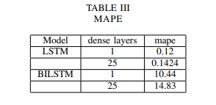
Table II has a score calculated for MAPE that determines the average percentage of variation between the expected and actual numbers to determine how accurate the model is then finally helps to select the model that acts as more accurate for the given series.
Table III contains the hyper-parameters that are used to tune the model. Various parameters help to uphold the model that can be deployed easily. LOSS and BATCH SIZE are represented in a relation.

Slide 21
SUMMARY
The proposed model for Enhancing Urban Cities’ Air Quality Prediction using deep learning techniques determines the BiLSTM model to be the best among the conventional models and the DaBiLSTM, LSTM model generated. BiLSTM model produces an RMSE value of 0.29 and NMSE of 0.0002 with the parameters included as Hidden layers and the number of LSTM layers built. Hyperparameter tuning includes dense layers and batch size optimizers these make the model much more optimized and produce effective values while predicting. To enhance the performance of the model,

Slide 22
Areas of focus further
DAFA-BiLSTM (DEEP AUTOGRESSION FEATURE- AUGMENTED BiLSTM) is introduced which makes the prediction more efficient and accurate. It is an advanced deep-learning model. It produces an RMSE value of 0.096.

Slide 23
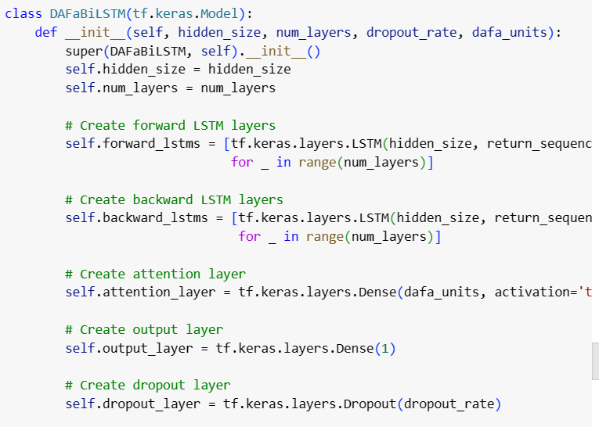
Dafa - bilstm

Slide 24
Thank you

